Slide 1
Number Systems and Codes
CSE 260 : Digital Logic Design

Slide 2
Binary Coded Decimal (BCD)
Decimal numbers are more natural to humans. Binary numbers are natural to computers. Quite expensive to convert between the two.
If little calculation is involved, we can use some coding schemes for decimal numbers.
One such scheme is BCD, also known as the 8421 code.
Represent each decimal digit as a 4-bit binary code.

Slide 3
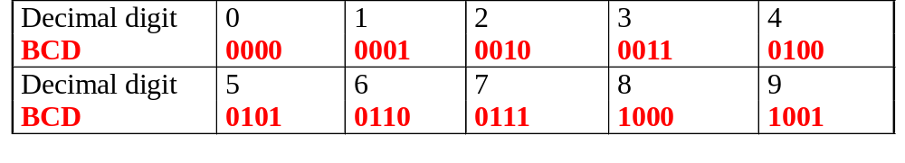
Binary Coded Decimal (BCD)
Some codes are unused, eg: (1010)_{BCD}, (1011) _{BCD}, …, (1111) _{BCD}. These codes are considered as errors.
Easy to convert, but arithmetic operations are more complicated.
Suitable for interfaces such as keypad inputs and digital readouts.

Slide 4
Binary Coded Decimal (BCD)
Examples:
(234)₁₀ = (0010 0011 0100)_{BCD}
(7093)₁₀ = (0111 0000 1001 0011)_{BCD}
(1000 0110)_{BCD} = (86)₁₀
(1001 0100 0111 0010)_{BCD} = (9472)₁₀
Notes: BCD is not equivalent to binary.
Example: (234)₁₀ = (11101010)₂

Slide 5
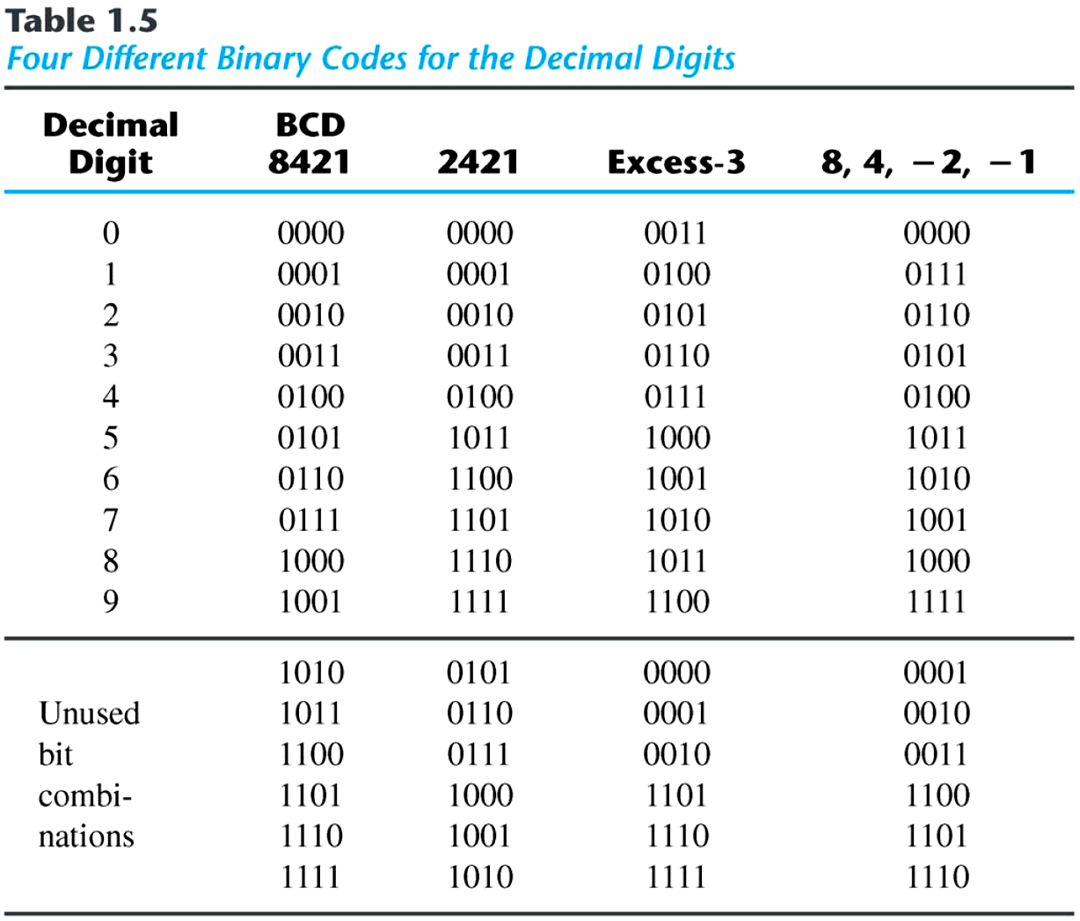
Binary Codes
■ Other Decimal Codes

Slide 6
Negative Numbers Representation
There are three common ways of representing signed numbers (positive and negative numbers) for binary numbers:
  Sign-and-Magnitude
  1s Complement
  2s Complement

Slide 7
Sign-and-Magnitude
Negative numbers are usually written by writing a minus sign in front.
  Example:
  - (12)₁₀ , - (1100)₂
In computer memory of fixed width, this sign is usually represented by a bit:
  0 for +
  1 for -

Slide 8
Sign-and-Magnitude
Example: an 8-bit number can have 1-bit sign and 7-bits magnitude.
sign
magnitude

Slide 9
Signed magnitude representation
Examples:
1101₂ = 13₁₀ (a 4-bit unsigned number)
0 1101 = +13₁₀ (a positive number in 5-bit signed magnitude)
1 1101 = -13₁₀ (a negative number in 5-bit signed magnitude)
0100₂ = 4₁₀ (a 4-bit unsigned number)
0 0100 = +4₁₀ (a positive number in 5-bit signed magnitude)
1 0100 = -4₁₀ (a negative number in 5-bit signed magnitude)
Subtraction (lvk)

Slide 10
Sign-and-Magnitude
Largest Positive Number: 0 1111111 +(127)₁₀
Largest Negative Number: 1 1111111 -(127)₁₀
Zeroes: 0 0000000 +(0)₁₀
1 0000000 -(0)₁₀
Range: -(127)₁₀ to +(127)₁₀
Signed numbers needed for negative numbers.
Representation: Sign-and-magnitude.

Slide 11
1s Complement
Given a number x which can be expressed as an n-bit binary number (i.e. integer part has n digits and fraction has m digit), its negative value can be obtained in 1s-complement representation using:
+7 0111
+6 0110
+5 0101
+4 0100
+3 0011
+2 0010
+1 0001
+0 0000
-7 1000
-6 1001
-5 1010
-4 1011
-3 1100
-2 1101
-1 1110
-0 1111

Slide 12
1’s complement
Approach 1
Approach 2
x_{base} =>base^{n} – base^{m}– x
Example: With an 8-bit number 00001100, its negative value, expressed in 1s complement, is obtained as follows
-(00001100)₂ = - (12)₁₀
=> (2⁸ - 2⁰ - 12)₁₀
=> (2⁸ - 1 - 12)₁₀
= (243)₁₀
= (11110011)_{1s}
-(00001100)₂
_{inverse}
(11110011)₂

Slide 13
1s Complement
Essential technique: invert all the bits.
Examples: 1s complement of 00000001 = (11111110)_{1s}
1s complement of 01111111 = (10000000)_{1s}
Range [in 8 bits]: -(127)₁₀ to +(127)₁₀
General Formula=-(2^{n-1} -1) to + (2^{n-1} -1)
The most significant bit still represents the sign:
0 = +ve; 1 = -ve.
Note: Range for n bit no. is –(2^(n-1)-1) to (2^(n-1)-1)

Slide 14
1s Complement
Examples (assuming 8-bit binary numbers):
(14)₁₀ = (00001110)₂ = (00001110)_{1s}
-(14)₁₀ = -(00001110)₂ = (11110001)_{1s}
-(80)₁₀ = -( ? )₂ = ( ? )_{1s}

Slide 15
Other (base-1) complements
Formula: r^{n}-r^{-m}-N
9’s Complement
Example:
  (52520)₁₀ is = 10⁵-1-52520
  =99999-52520
  =47479
  (25.639)₁₀ is =10²-10⁻³-25.639
  =99.999-25.639
  =74.360

Slide 16
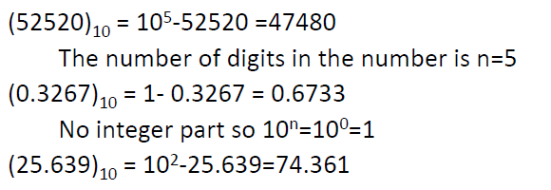
Other base complements
10’s Complement

Slide 17
2s Complement
Given a number x which can be expressed as an n-bit (i.e. integer part has n digits and fraction has m digit) number , its negative number can be obtained in 2s-complement representation using:
- x = 2^{n} - x
Example: With an 8-bit number 00001100, its negative value in 2s complement is thus:
-(00001100)₂ = - (12)₁₀
= (2⁸ - 12)₁₀
= (244)₁₀
= (11110100)_{2s}

Slide 18
2s Complement
Method 1: Essential technique: invert all the bits and add 1.
Examples:
2s complement of
(00000001)_{2s} = (11111110)_{1s} (invert i.e 1’s complement)
= (11111111)_{2s} (add 1)
2s complement of
(01111110)_{2s} = (10000001)_{1s} (invert i.e 1’s complement)
= (10000010)_{2s} (add 1)
Method 2: Keep unchanged till 1st occurrence of 1 from LSB and invert remaining 1’s into 0’s and 0’s into 1’s till MSB
(01111110)_{2s} = (10000010)_{2s}
Official method!
Unofficial method!
Unchanged
Inverted

Slide 19
2s Complement
Range in 8 bits: -(128)₁₀to +(127)₁₀
General Formula= -(2^{n-1}) to + (2^{n-1} -1)
The most significant bit still represents the sign:
0 = +ve; 1 = -ve.
Note: Range for n bit no. is -2^(n-1) to 2^(n-1)-1
Notes:
01111111 = +127
01111110 = +126
01111101 = +125
...
00000001 = +1
00000000 = 0
11111111 = -1
...
10000010 = -126
10000001 = -127
10000000 = -128

Slide 20
2s Complement
Examples (assuming 8-bit binary numbers):
(14)₁₀ = (00001110)₂ = (00001110)_{2s}
-(14)₁₀ = -(00001110)₂ = (11110010)_{2s}
-(80)₁₀ = -( ? )₂ = ( ? )_{2s}

Slide 21
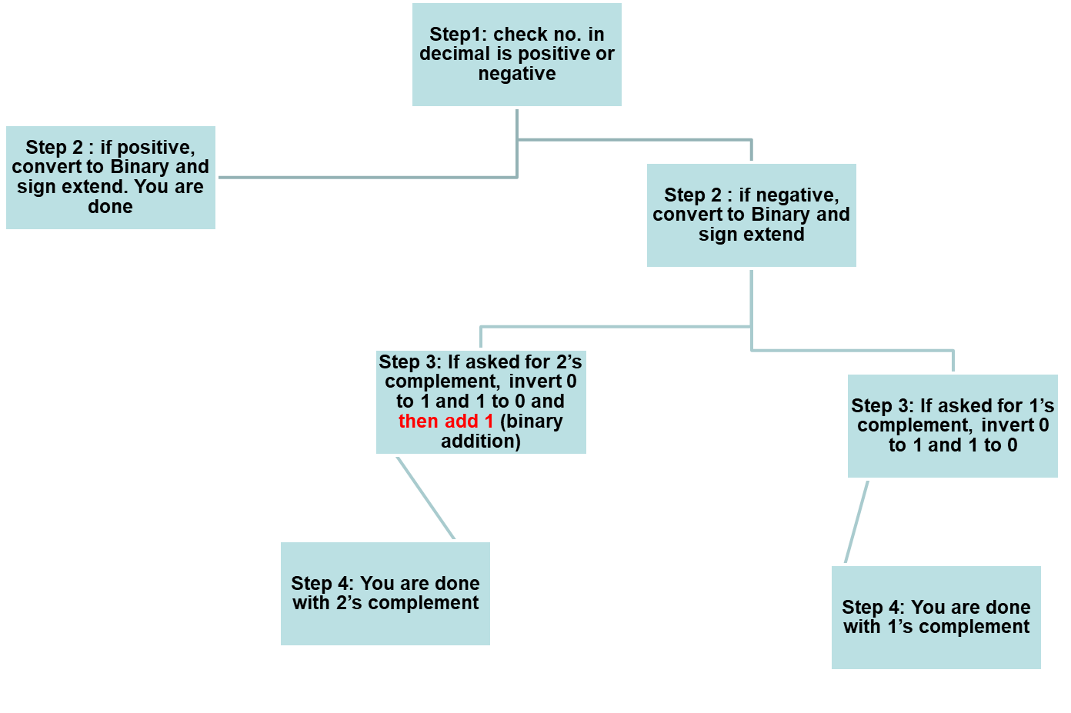
Summary of what we learnt so far

Slide 22
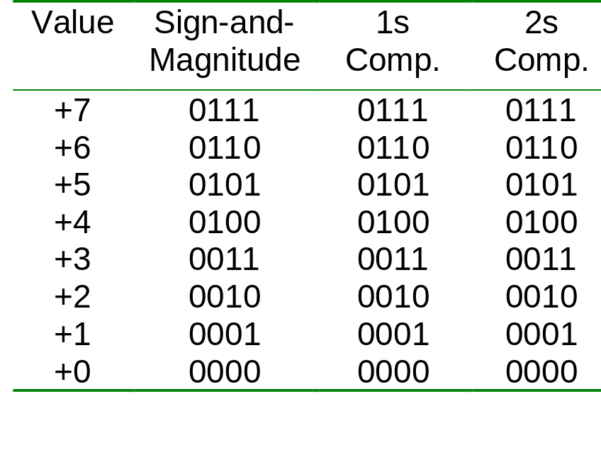
Comparisons of Sign-and-Magnitude and Complements
Example: 4-bit signed number (positive values)
Note: Signed magnitude cannot be used for arithmetic calculations

Slide 23
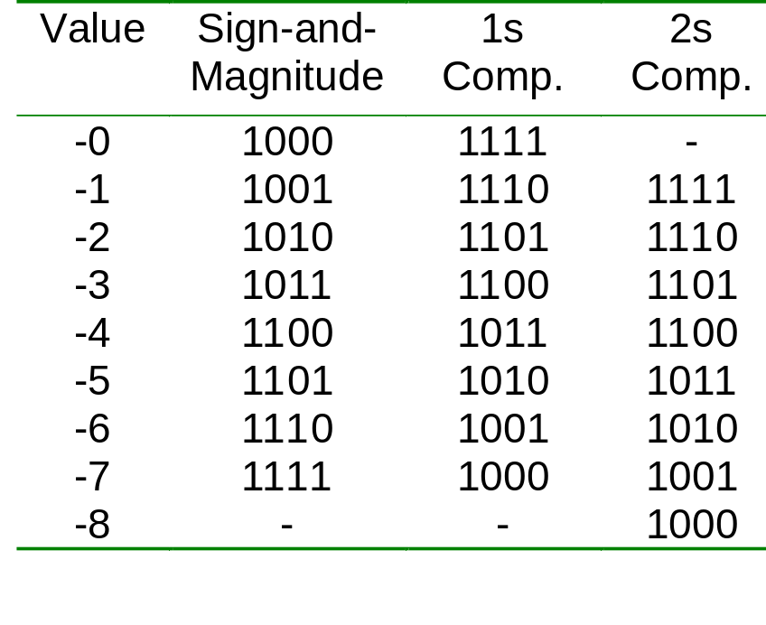
Comparisons of Sign-and-Magnitude and Complements
Example: 4-bit signed number (negative values)
Note: Signed magnitude cannot be used for arithmetic calculations

Slide 24
Exercise:
1. For 2’s complement binary numbers, the range of values for 5-bit numbers is
a. 0 to 31 b. -8 to +7 c. -8 to +8
d. -15 to +15 e. -16 to +15
2. In a 6-bit 2’s complement binary number system, what is the decimal value represented by (100100)_{2s}?
a. -4 b. 36 c. -36 d. -27 e. -28

Slide 25
Practice Time
1) Following numbers are in 1’s complement system. Turn them to their no. negative representation
1010101
0111000
0000001
00000
2) Now perform 2’s complement

Slide 26
Answer
1’s complement
2’s complement
A. Already negative
B. 1000111
C. 1111110
D.11111
Already negative
1001000
1111111
00000

Slide 27
Comparison between 1’s and 2’s complement
1’s complement
2’s complement
Easier to implement (convert between 0s and 1s)
2 representation of 0 (0000,1111)
1’s complement is mostly used in non-arithmetic applications
Easier substraction (no need of adding 1 in the case of carry)
2’s complement is mostly used in arithmetic applications

Slide 28
UNSIGNED NO. ARTHEMATIC OPERATION!

Slide 29
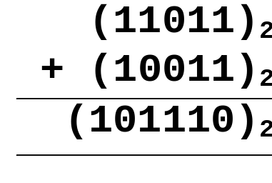
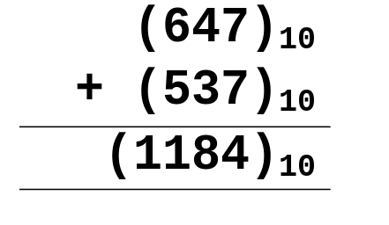
Binary Arithmetic Operations for Unsigned numbers
ADDITION
Like decimal numbers, two numbers can be added by adding each pair of digits together with carry propagation.

Slide 30
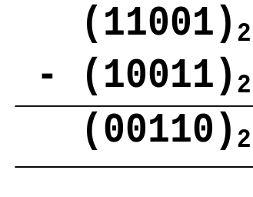
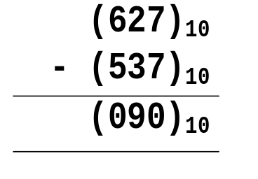
Binary Arithmetic Operations for Unsigned Numbers
SUBTRACTION
Two numbers can be subtracted by subtracting each pair of digits together with borrowing, where needed.

Slide 31
Overflow!

Slide 32
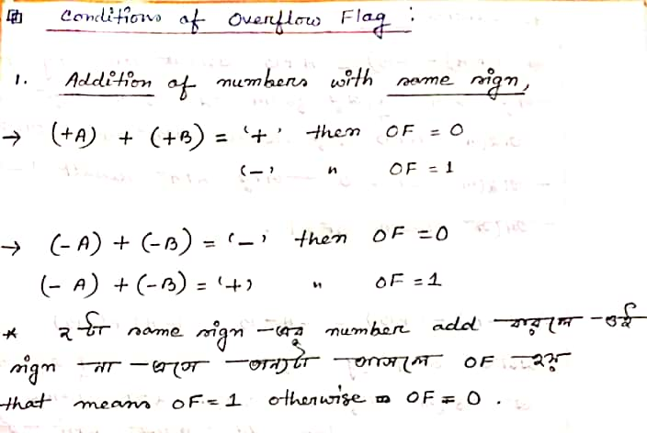

Slide 33
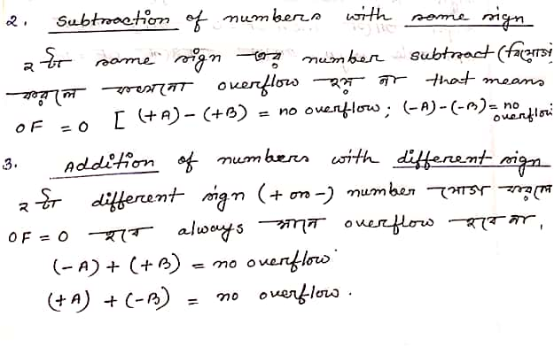

Slide 34
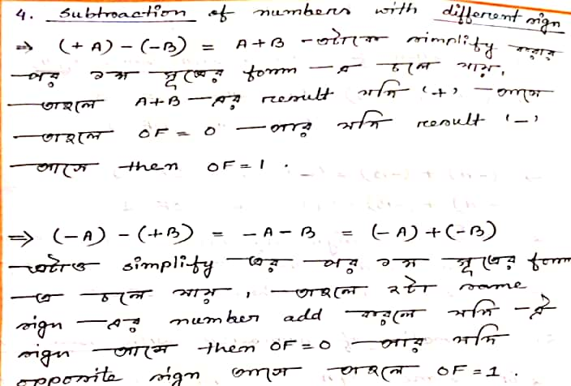

Slide 35
ARITHMETIC OPERATIONS ON SIGNED NUMBER

Slide 36
2s Complement Addition/Subtraction
Algorithm for addition, A + B:
Perform binary addition on the two numbers.
Ignore the carry out of the MSB (most significant bit).
Check for overflow: Overflow occurs if the ‘carry in’ and ‘carry out’ of the MSB are different, or if result is opposite sign of A and B.
Algorithm for subtraction, A – B:
A – B = A + (–B)
Take 2s complement of B by inverting all the bits and adding 1.
Add the 2s complement of B to A.

Slide 37
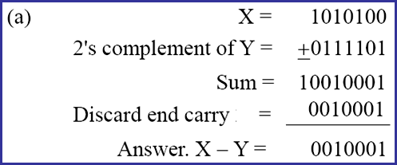
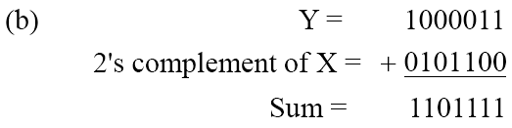
2s Complements Example
Given the two binary numbers X = 1010100 and Y = 1000011, perform the subtraction (a) X – Y and (b) Y − X by using 2's complement.

Slide 38
2s Complement Addition/Subtraction
Examples: 4-bit binary system
Which of the above is/are overflow(s)?
+3 0011
+ +4 + 0100
---- -------
+7 0111
---- -------
-2 1110
+ -6 + 1010
---- -------
-8 11000
---- -------
+6 0110
+ -3 + 1101
---- -------
+3 10011
---- -------
+4 0100
+ -7 + 1001
---- -------
-3 1101
---- -------

Slide 39
2s Complement Addition/Subtraction
More examples: 4-bit binary system
Which of the above is/are overflow(s)?
-3 1101
+ -6 + 1010
---- -------
-9 10111
---- -------
+5 0101
+ +6 + 0110
---- -------
+11 1011
---- -------

Slide 40
1s Complement Addition/Subtraction
Algorithm for addition, A + B:
Perform binary addition on the two numbers.
If there is a carry out of the MSB, add 1 to the result.
Check for overflow: Overflow occurs if result is opposite sign of A and B.
Algorithm for subtraction, A – B:
A – B = A + (–B)
Take 1s complement of B by inverting all the bits.
Add the 1s complement of B to A.

Slide 41
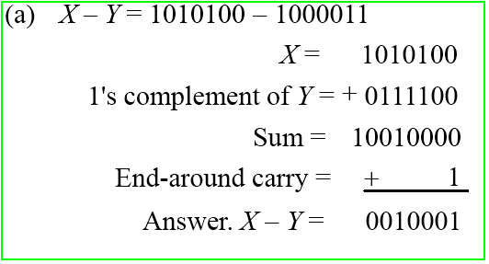
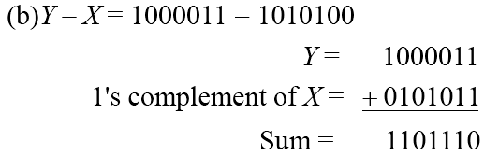
1s Complements Example
Repeat Previous Example, but this time using 1's complement.

Slide 42
1s Complement Addition/Subtraction
Examples: 4-bit binary system
+3 0011
+ +4 + 0100
---- -------
+7 0111
---- -------
+5 0101
+ -5 + 1010
---- -------
-0 1111
---- -------
-2 1101
+ -5 + 1010
---- ------
-7 10111
---- + 1
------
1000
-3 1100
+ -7 + 1000
---- -------
-10 10100
---- + 1
-------
0101

Slide 43
Exercise:
In a 4-bit twos-complement scheme, what is the result of this operation: (1011)_{2s} + (1001)_{2s}?
a. 0100 b. 0010 c. 1100 d. 1001 e. overflow
2. Assuming a 6-bit system, perform subtraction with the following unsigned binary numbers by taking first the 1's complement, and then, the 2's complement, of the second value and adding it with the first value:
(a) 011010 – 010000 (26 – 16)
(b) 011010 – 001101 (26 – 13)
(c) 000011 – 010000 (3 – 16)

Slide 44
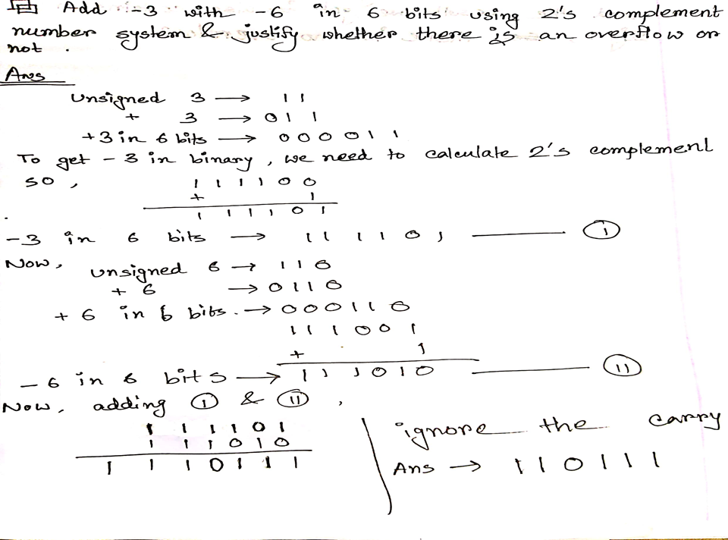

Slide 45
